Slide 1
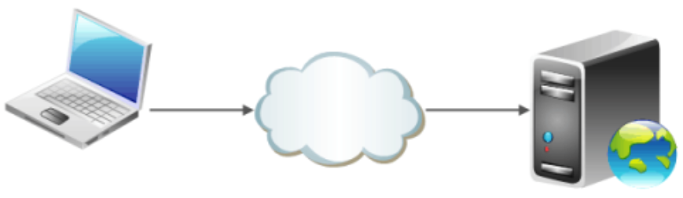
What is a Web Server? And how it Works?
Dr. Muhammad Habib

Slide 2
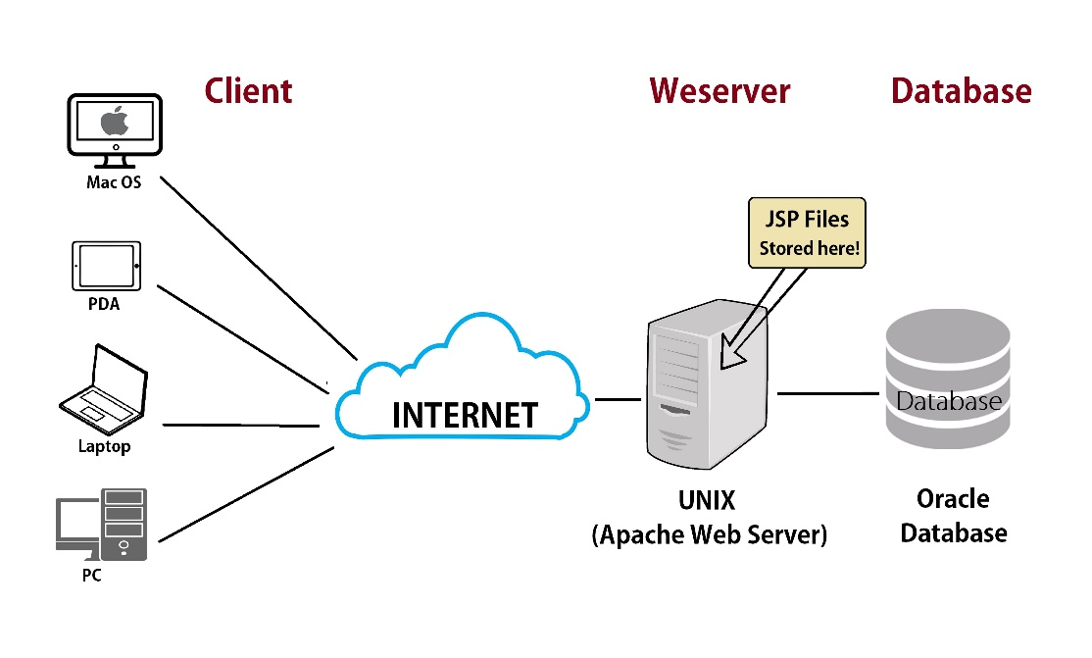
Web Server
A server is a computer that runs applications and services ranging from websites to instant messaging.
It's called a server because it provides a service to another computer and its user also known as the client.

Slide 3
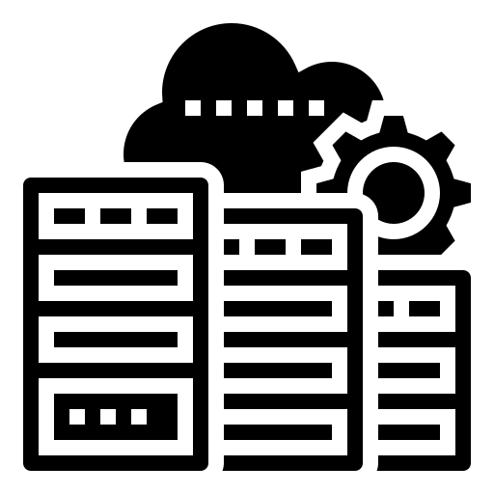
Data Center
Servers are typically stored in something called a data center with hundreds or thousands of other servers, all running different services connected to the internet.

Slide 4
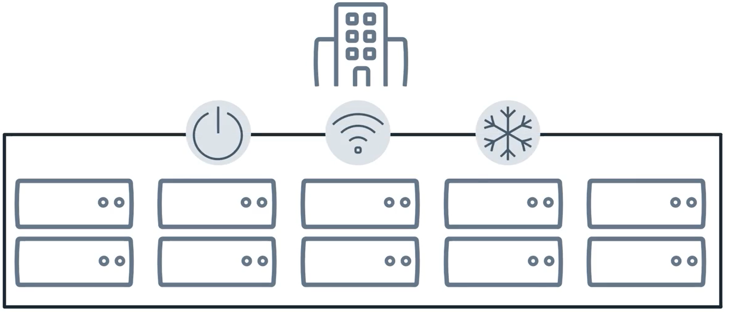
Data Center
There are many different systems in data centers to ensure that servers have continuous power, continuous internet connection and are kept cooled 24 hours per day.

Slide 5
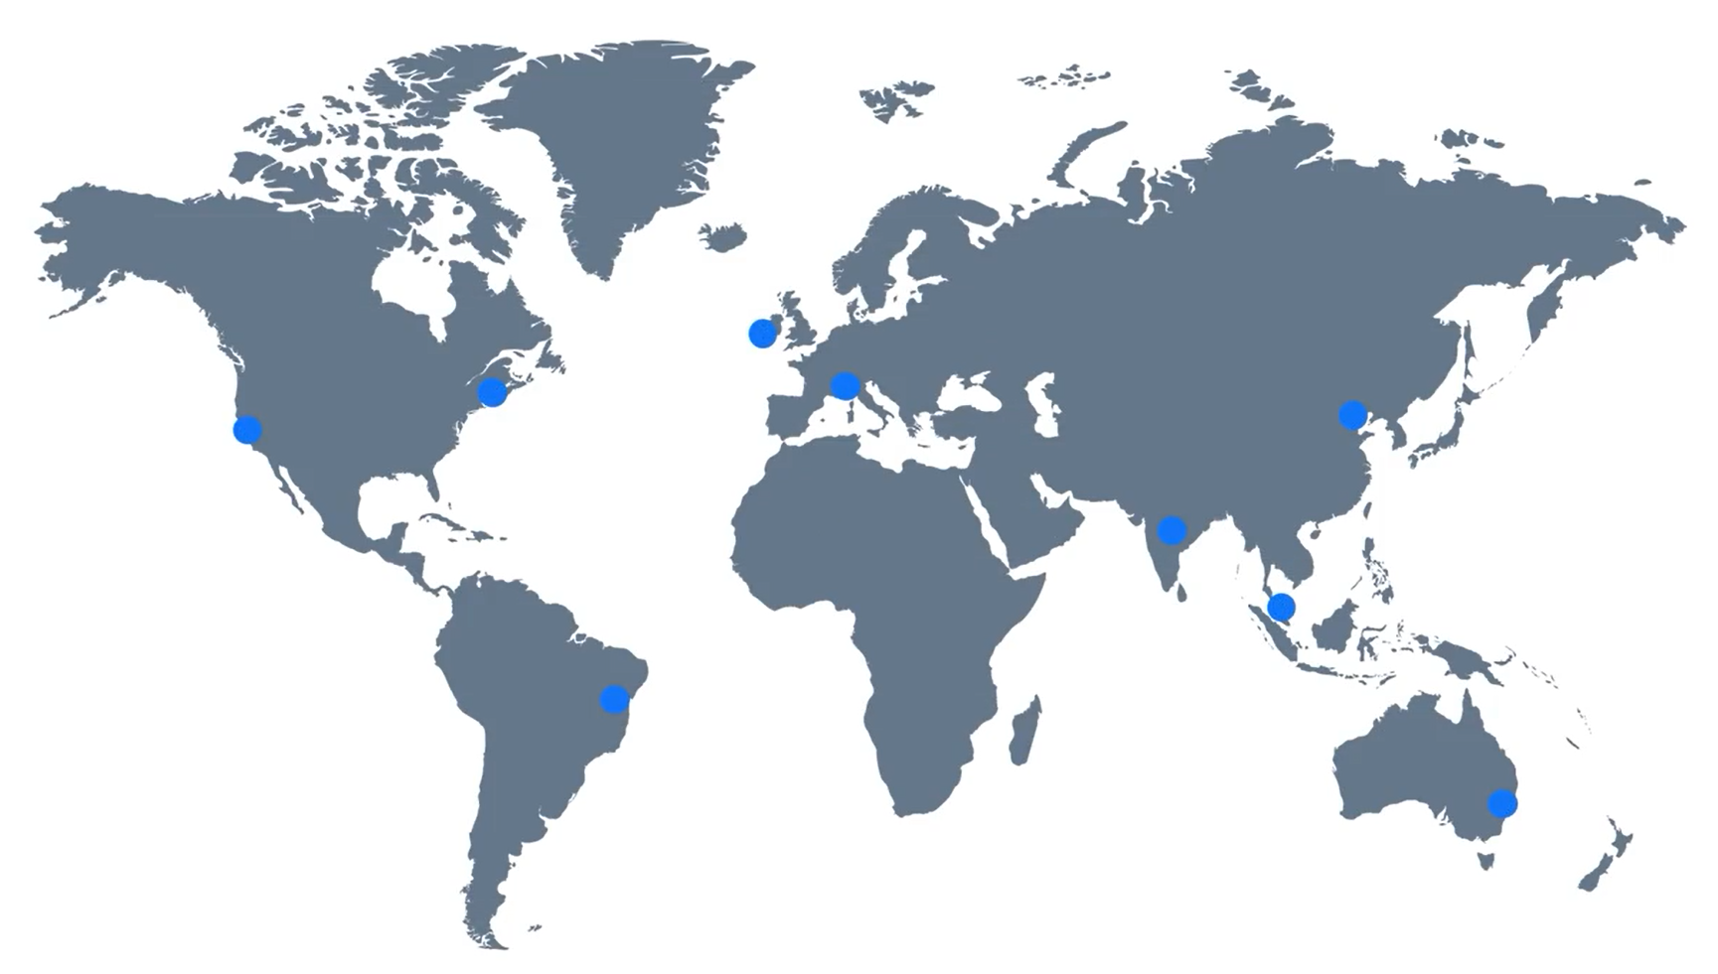
Data Centers
Did you know that there are data centers located all around the world?

Slide 6
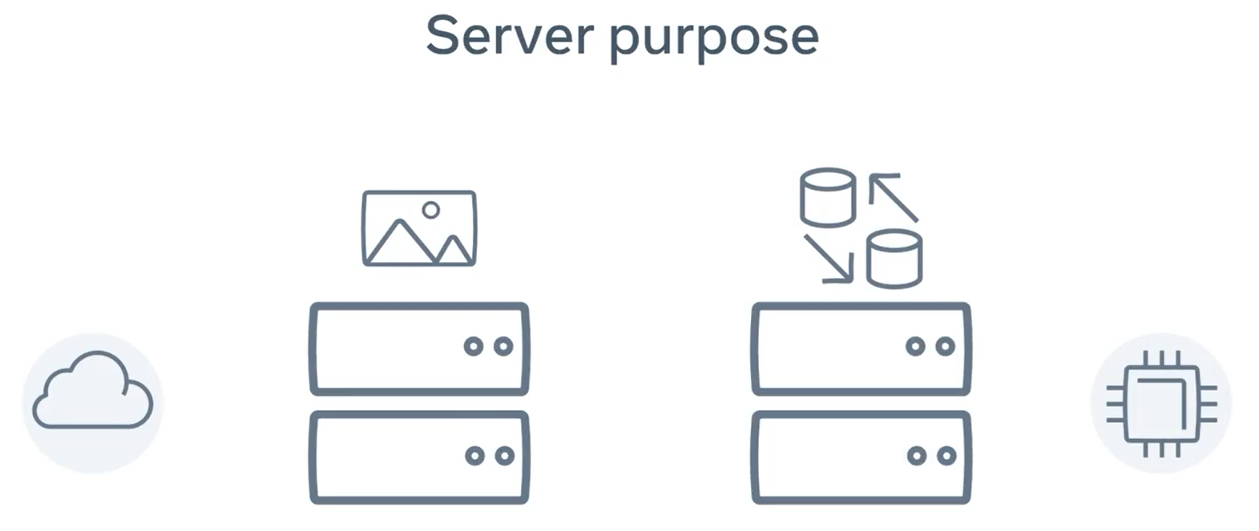
Data Centers
Many websites use these to allow you to access your content quickly from the data center nearest to you.
The data center servers are built based on the service purpose.
For example, if the server is only to be used for storing images, it might have a lot of hard drive space.

Slide 7
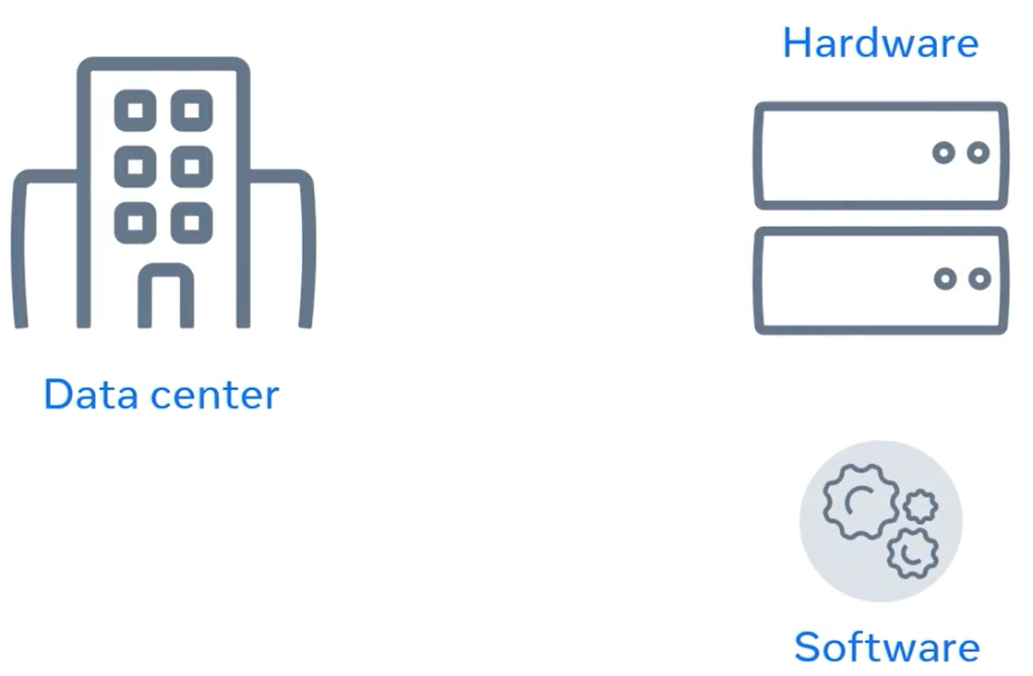
Data Centers
Whereas a server computing complex calculations might need a fast processor and a lot of memory.
This is usually referred to as a server hardware. The physical components of a server.
Once the server hardware is installed in the data center, a piece of code can now run.

Slide 8
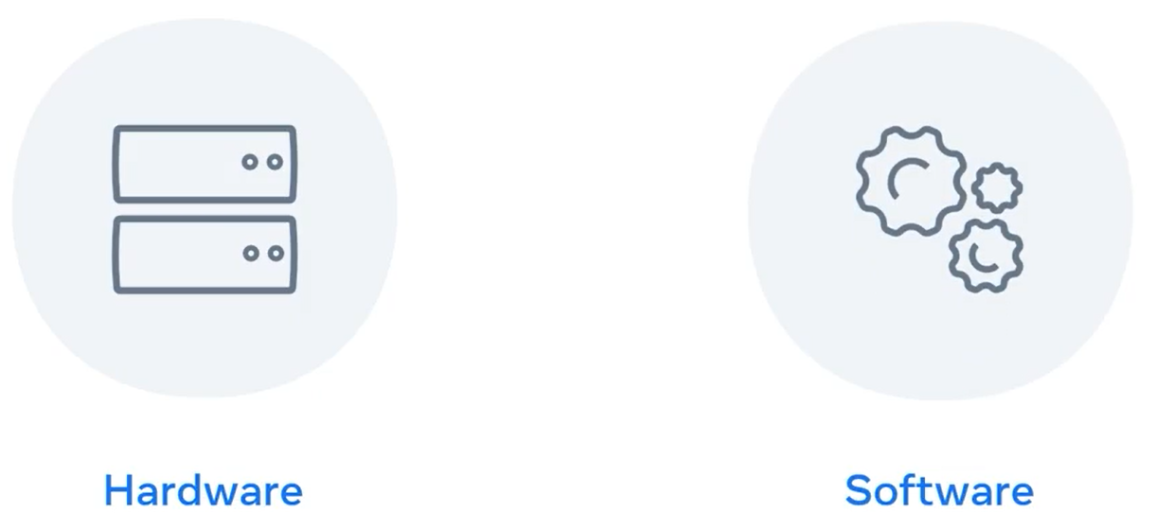
Data Centers
The code that runs on the hardware is commonly known as software.
One way I like to remember this is to think of hardware as something you can physically touch and is difficult to change as you need to physically replace components.

Slide 9
Data Centers
Software is soft or easy to change. You just replace the code running on the server.

Slide 10
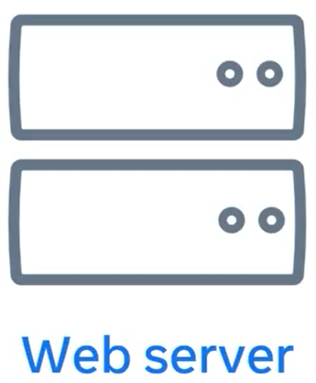
Web Server
The services on a server can run, can vary, but in this lecture you will learn more about a type of service software known as a web server.

Slide 11
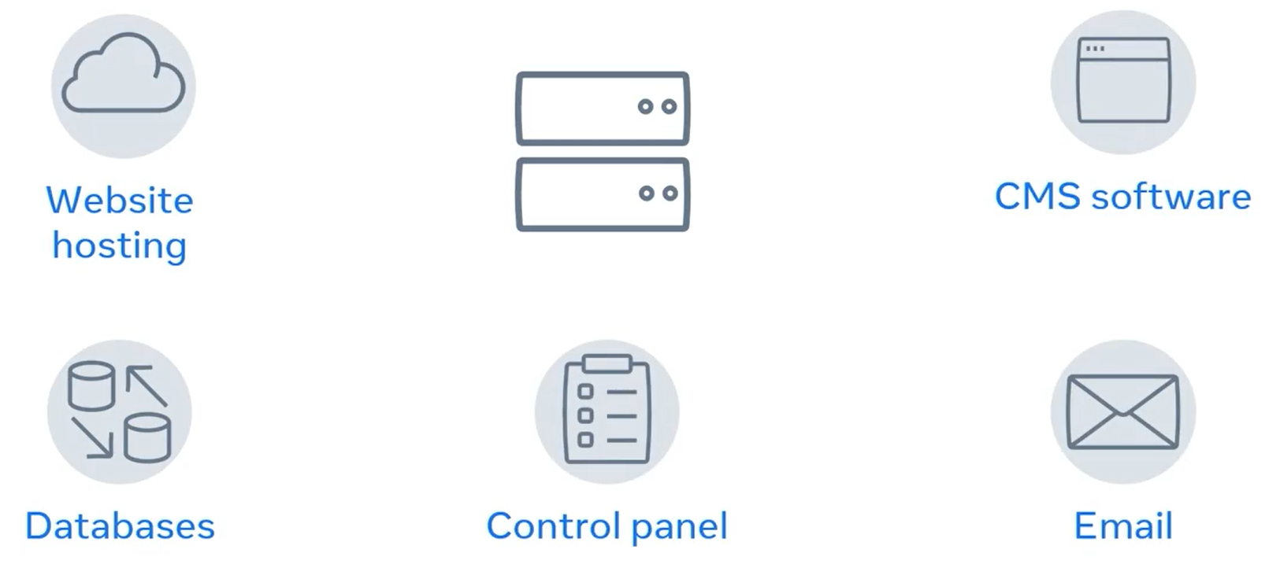
Web Server
A web server has many functions which includes website storage and administration, data storage, security and managing email.

Slide 12
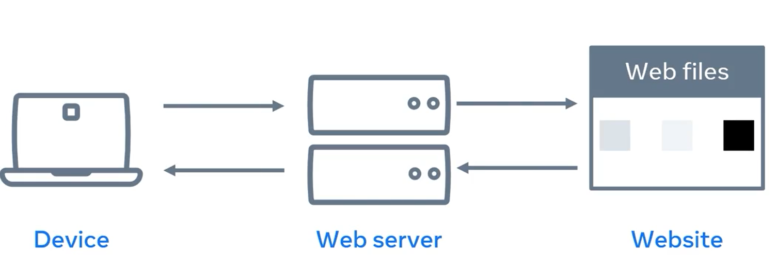
Web Server
Another primary function is to handle something known as a web request.
When you open a browser on your device and type the name of the website, it's the job of the web server to send you back to that website's content.

Slide 13
Web Server (Request-Response Cycle)
This process is known as the request response cycle and you will learn more about it later.

Slide 14
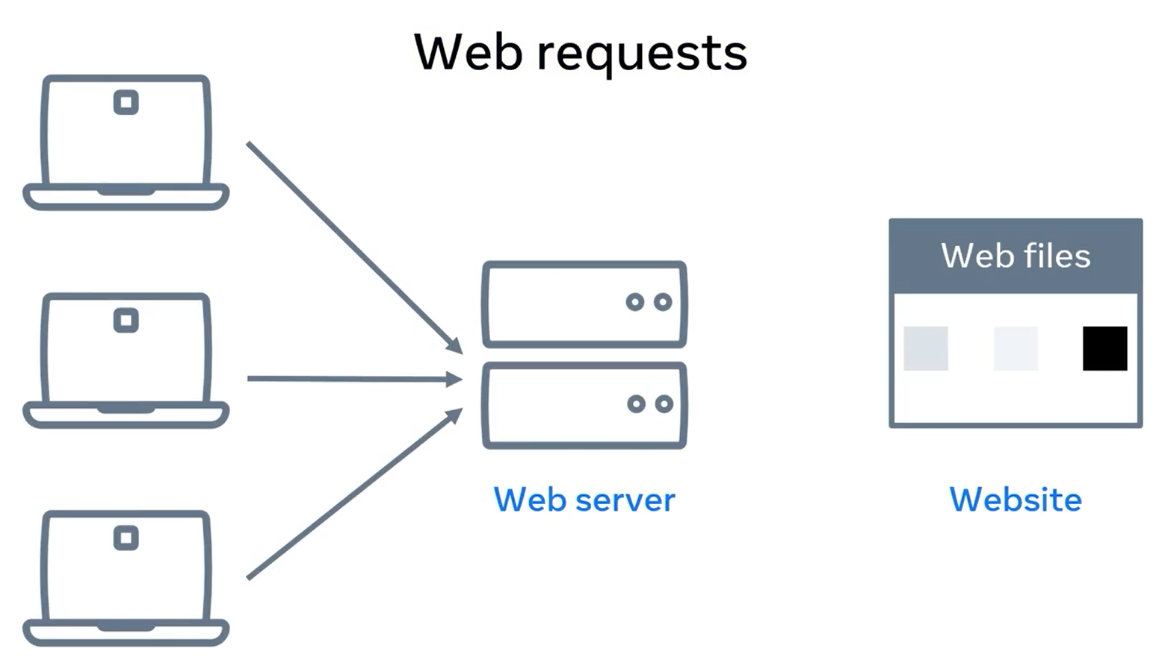
Web Server (Request-Response Cycle)
Web servers are also designed to respond to thousands of requests from clients per second.

Slide 15
Summary
In this lecture, you learned about web servers and how they consist of hardware and software.
You also learned that one of the primary roles of a web server is to respond to web requests from the client.

Slide 16
Additional Resources
Learn more Here is a list of resources that may be helpful as you continue your learning journey.
What is a Web Server? (NGINX)
https://www.nginx.com/resources/glossary/web-server/
What is a Web Browser? (Mozilla)
https://www.mozilla.org/en-US/firefox/browsers/what-is-a-browser/
Who invented the Internet? And why? (Kurzgesagt)
https://youtu.be/21eFwbb48sE
What is Cloud Computing? (Amazon)
https://youtu.be/mxT233EdY5c
Browser Engines (Wikipedia)
https://en.wikipedia.org/wiki/Browser_engine

Slide 17
Thank You

